Slide 1
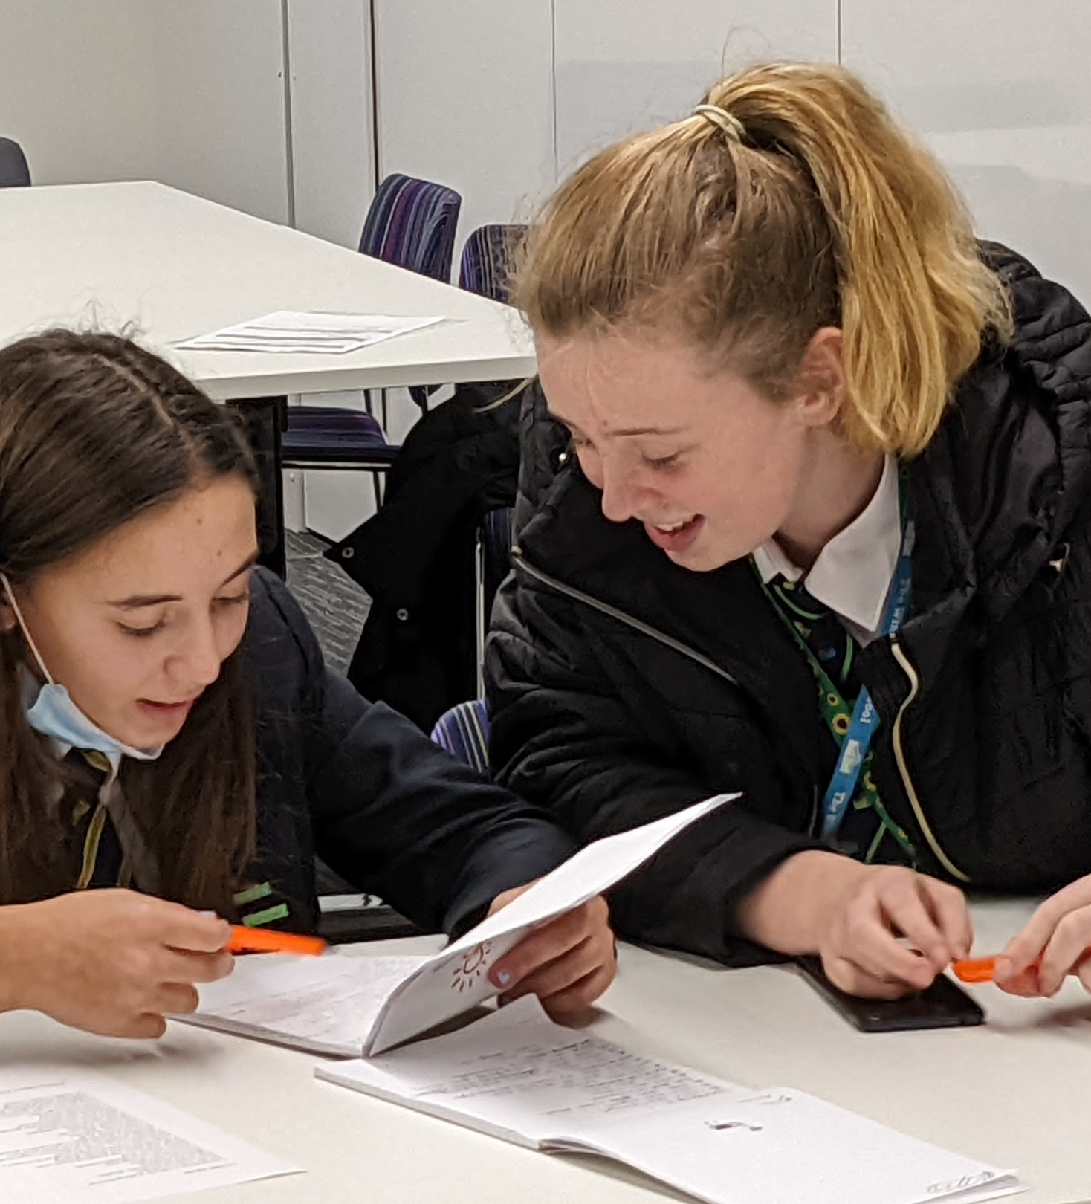
DIALECT
AND SLANG
An activity by Andrew Graves
Lost Words
Teaching Resources

Slide 2
What is ‘dialect’?
Lost Words
Teaching Resources
Notes:
Explain what dialect is – a way of speaking (vocabulary, grammar, pronunciation) specific to a region or social group.
Ask if any of the group knows what any of these words mean.
Then show next three slides and see how many they got right.

Slide 3
Dialect words
Lost Words
Teaching Resources
teggies
nebbeh
pissmire

Slide 4
Dialect words
Lost Words
Teaching Resources
battletwig
blather-yeded
cow lady

Slide 5
Dialect words
Lost Words
Teaching Resources
What dialect words do you know?
snaptin
nesh
Notes:
Ask for a few suggestions from the group then move to the next slide.

Slide 6
Lost Words
Teaching Resources
Write a list of dialect words you know
Dialect words are only used in one region or by one social group.
Dialect words you know might be:
words you use with your friends
words your family uses
words you’ve heard older people use
words you hear in your neighbourhood
Notes:
It’s worth putting them into smaller groups for this task – they will encourage each other to come up with words.

Slide 7
Lost Words
Teaching Resources
Make up new dialect words
Choose a topic from:
clothes
food
home
Write down five
words relating to that topic.
For example: home
toilet, settee, teapot, XBox, bedroom
Notes:
This and the next slide can be done individually or as a group, but it will work better if they stay in their groups.

Slide 8
Lost Words
Teaching Resources
Make up new dialect words
For each of your five words, write down any dialect words you know, and make up one or more new words.
For example:
settee – sofa, couch, snuggleseat
teapot – mashpot, brewjar
XBox – battlebox, gamebox
toilet – lavvy, bog, plopseat

Slide 9
Let’s share
Would anyone like to share some of their dialect words with the group?
Can the group guess what the words mean?
If you're reading, remember: this is only your first draft. Nobody is expecting perfection so read loud and proud!
If you’re listening, remember: listen gratefully and sincerely. Offer positive, specific feedback if you can – it’s helpful and validating.
Notes:
Don’t insist everyone shares their work, but gently encourage them to do so.
If working in groups, ask one person from each group to share.
Ask them to speak more loudly if they cannot be heard.
Give specific and positive feedback and encourage the rest of the group to give feedback too.

Slide 10





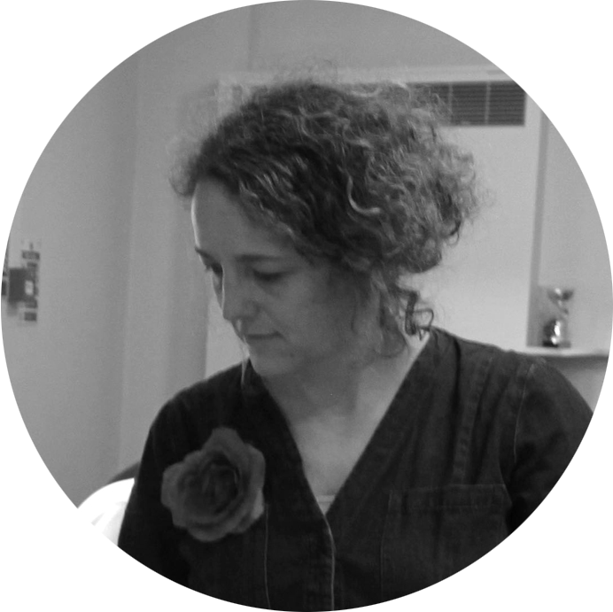



Lost Words
Teaching Resources
Andrew Graves
writer
Hannah Sawtell
artist
Natalie Braber
project director

