Slide 1
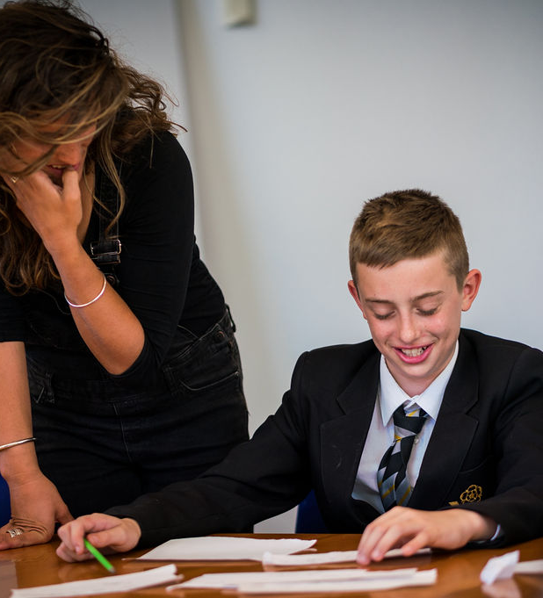
WHAT DOES IT MEAN?
“Ollin it dahn”
Lost Words
Teaching Resources

Slide 2
What does this mean?
Lost Words
Teaching Resources
Notes:
Depending on the group, there might not be anyone who knows what this means (raining very heavily). Encourage them to guess.

Slide 3
Lost Words
Teaching Resources
How many words are there for rain?
Write down as many words for rain or phrases about rain as you can think of.
You could make some up if you like!
For example
Drizzle, thunderstorm, raining cats and dogs, umbrella weather.
Notes:
This could be done as a whole-group exercise, in small groups or individually.
If not done as a whole group, ask for a few examples after this part of the exercise and write them up on the whiteboard/screen.

Slide 4
Lost Words
Teaching Resources
How many words are there for rain?
Write a conversation between two people about the weather, using some of your words or phrases.
Notes:
This could be done individually or in pairs.
Remind them to try and make the conversation sound natural, rather than simply trying to squeeze as many words/phrases for rain in as they can.

Slide 5
Let’s share
Would anyone like to share their conversation with the group?
If you're reading, remember: this is only your first draft. Nobody is expecting perfection so read loud and proud!
If you’re listening, remember: listen gratefully and sincerely. Offer positive, specific feedback if you can – it’s helpful and validating.
Notes:
Don’t insist everyone shares their work, but gently encourage them to do so.
Demonstrate how to read clearly and audibly.
If they’ve been working in pairs, ask each partner to take one side of the conversation.
If they’ve been working individually, consider asking them to give one side of the conversation to a friend to read.
If someone is reading quietly ask them (only once, don’t keep stopping them) to speak more loudly so that everyone can hear their work.
Give specific and positive feedback and encourage the rest of the group to give feedback too.

Slide 6




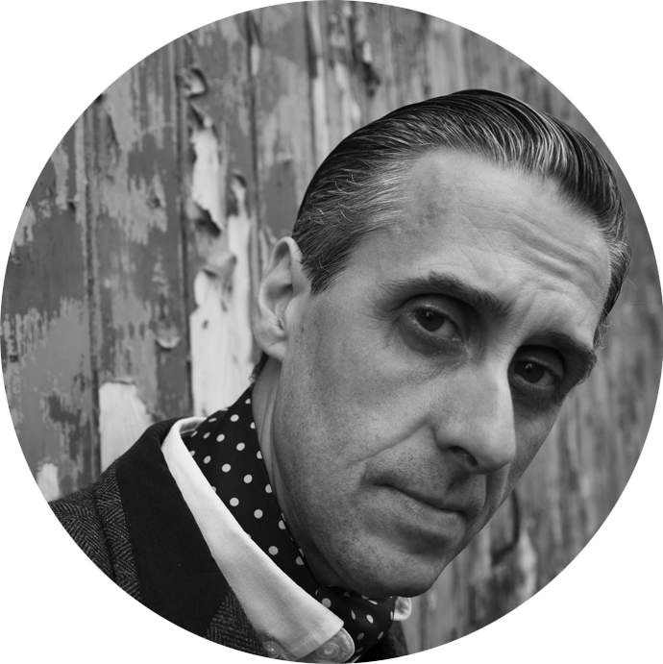
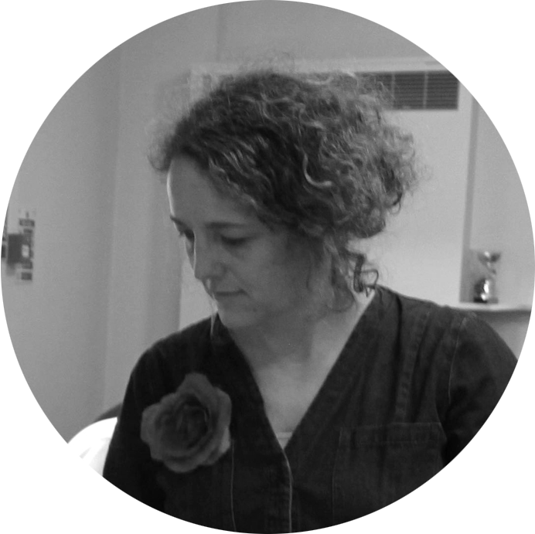
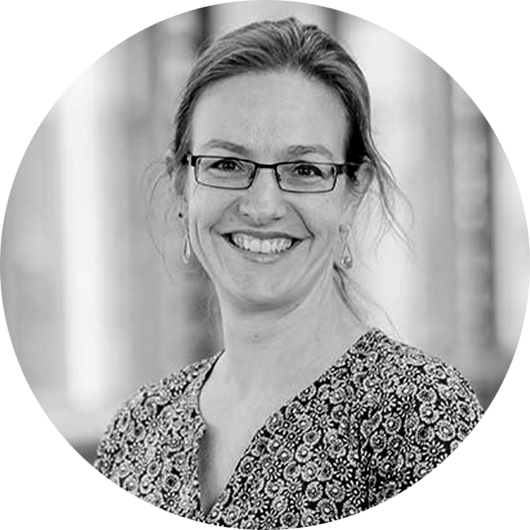


Lost Words
Teaching Resources
Andrew Graves
writer
Hannah Sawtell
artist
Natalie Braber
project director

