Slide 1

WHAT DOES IT MEAN?
An activity by Andrew Graves
Lost Words
Teaching Resources

Slide 2
What does this mean?
Lost Words
Teaching Resources

Slide 3
Lost Words
Teaching Resources

Slide 4
What does this mean?
Lost Words
Teaching Resources

Slide 5
Lost Words
Teaching Resources

Slide 6
What does this mean?
Lost Words
Teaching Resources

Slide 7
Lost Words
Teaching Resources

Slide 8
What does this mean?
Lost Words
Teaching Resources

Slide 9
Lost Words
Teaching Resources

Slide 10
What does this mean?
Lost Words
Teaching Resources

Slide 11
Lost Words
Teaching Resources

Slide 12
What does this mean?
Lost Words
Teaching Resources

Slide 13
Lost Words
Teaching Resources

Slide 14
What does this mean?
Lost Words
Teaching Resources

Slide 15
Lost Words
Teaching Resources

Slide 16
What does this mean?
Lost Words
Teaching Resources

Slide 17
Lost Words
Teaching Resources

Slide 18
What does this mean?
Lost Words
Teaching Resources

Slide 19
Lost Words
Teaching Resources

Slide 20
What does this mean?
Lost Words
Teaching Resources

Slide 21
Lost Words
Teaching Resources

Slide 22
What does this mean?
Lost Words
Teaching Resources

Slide 23
Lost Words
Teaching Resources

Slide 24
What does this mean?
Lost Words
Teaching Resources

Slide 25
Lost Words
Teaching Resources

Slide 26
What does this mean?
Lost Words
Teaching Resources

Slide 27
Lost Words
Teaching Resources

Slide 28
What does this mean?
Lost Words
Teaching Resources

Slide 29
Lost Words
Teaching Resources

Slide 30
Make up some words!
Lost Words
Teaching Resources
Invent some dialect words of your own.
These could mean:
an object
a mood
an action
a kind of person
etc.
Write a definition for each.
For example
boddy = a person
book-boddy = a librarian
roof-over = a house or a home
snarted = upset, miserable
footing = kicking a football
Notes:
Depending on the group, you could:
ask them to work individually
have a whole-group discussion
divide them into smaller groups to work together
You could have a short whole-group discussion then move to one of the other two alternatives for the main part of the writing exercise.

Slide 31
Let’s share
Pick your favourite one or two dialect words to share with the group. See if they can guess what your words mean!
If you're reading, remember: this is only your first draft. Nobody is expecting perfection so read loud and proud!
If you’re listening, remember: listen gratefully and sincerely. Offer positive, specific feedback if you can – it’s helpful and validating.
Notes:
Don’t insist everyone shares their work, but gently encourage them to do so.
If working in groups, ask one person from each group to share.
Remind them to read only the words, and not to give away what they mean.
Ask them to speak more loudly if they cannot be heard.
Give specific and positive feedback and encourage the rest of the group to give feedback too.

Slide 32





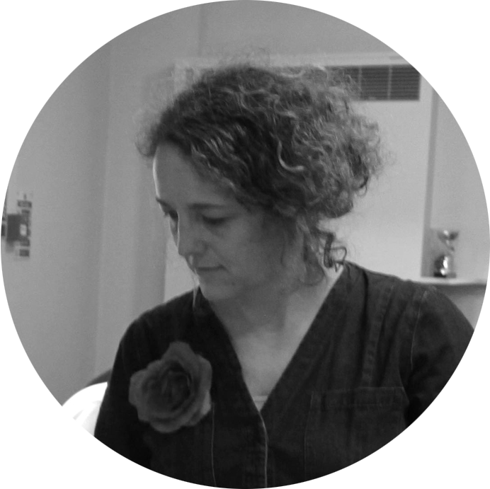



Lost Words
Teaching Resources
Andrew Graves
writer
Hannah Sawtell
artist
Natalie Braber
project director

